Slide 1
Medicaid Billing for Smoking Cessation
Advice, Scenarios, and Questions from the field
February 21, 2012

Slide 2
Sayone Thihalolipavan, MD, MPH
Director of Cessation, NYC Department of Health and Mental Hygiene
Brief Introduction &
NYS Medicaid Smoking Cessation Benefit in Practice
Slides courtesy of Manhattan Tobacco Cessation Program

Slide 3
Agenda:
Purpose of call
Introduction to the NYS Medicaid Smoking Cessation Benefit
Damian Family Care Center experience
Examples of General Billing Scenarios from the field
Questions

Slide 4
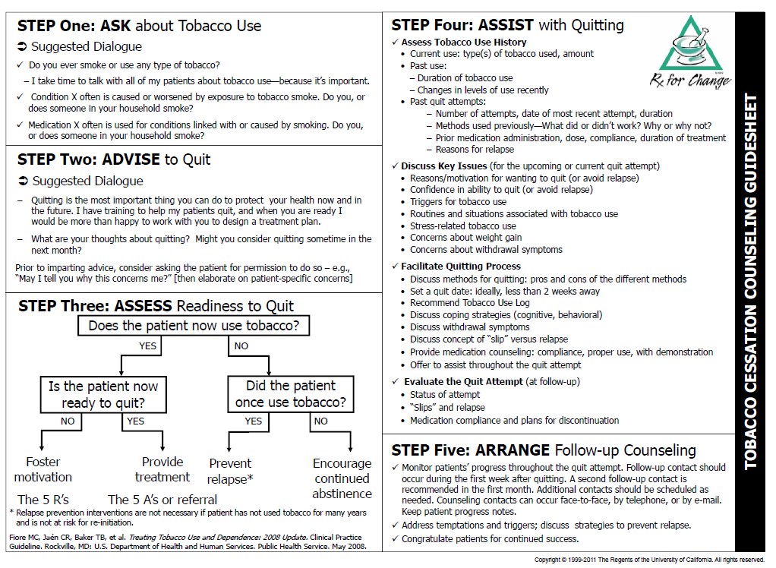
Evidence-Based Counseling Techniques Should be Used as a Guide to Documenting SCC
http://rxforchange.ucsf.edu/

Slide 5
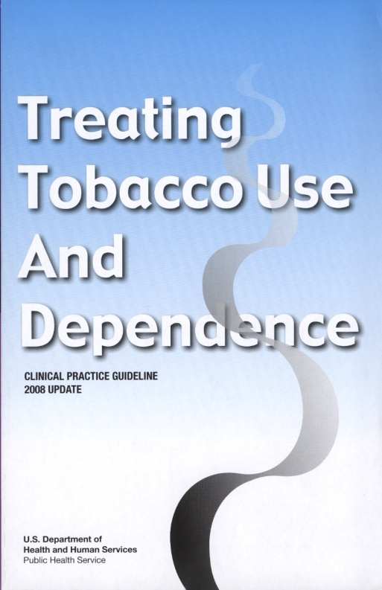
Steps to Translating Medicaid Policy into Practice
Implement clinical reminder system
Ensure that staff (clinical and administrative) receive training on 2008 Update on Tobacco Use Treatment Guidelines
Implement tobacco use referral systems

Slide 6
Steps to Translating Medicaid Policy into Practice Continued
Identify tasks for key personnel
  Billing department and administrators
    Ensuring correct CPT and ICD-9 codes are in electronic or paper charts
  Providers
    Medical directors and practice administrators communicate and educate on billing and reimbursement updates
    Educate re who can bill for counseling services
      MDs/DOs, NPs, LMs, PAs
Cessation Centers

Slide 7
Supporting Materials
New York City Medicaid Smoking Cessation Benefit Reimbursement FAQ sheet
http://www.nyc.gov/html/doh/downloads/pdf/smoke/smoke-medicaid-reimbursement-faq.pdf
Medicaid Update articles pertaining to Smoking Cessation;
  Medicaid Reimbursement Rates for Smoking Cessation Counseling (SCC) - May 2011
    http://www.health.ny.gov/health_care/medicaid/program/update/2011/2011-05.htm#rat
  Expansion of Smoking Cessation Counseling to all Medicaid Beneficiaries- April 2011
    http://www.health.ny.gov/health_care/medicaid/program/update/2011/2011-04.htm#exp
  Smoking Cessation Counseling Offered – Dec. 2009
    http://www.health.ny.gov/health_care/medicaid/program/update/2009/2009-12.htm#smo
  Medicaid to offer smoking cessation counseling for pregnant women – Oct. 2008
    http://www.health.ny.gov/health_care/medicaid/program/update/2008/2008-10.htm#med
APG information is available on the following DOH website;
    http://www.nyhealth.gov/health_care/medicaid/rates/apg
  Provider Manual
    http://www.nyhealth.gov/health_care/medicaid/rates/apg/docs/apg_provider_manual

Slide 8
Introduction to the NYS Medicaid Smoking Cessation Benefit
  Mark A. Tremblay, M.P.A., M.A.
  Bureau of Medical, Dental and Health Information Technology Policy
  Division of Program Development & Management
  Office of Health Insurance Programs
Presented by the New York State Office of Health Insurance Programs

Slide 9
Smoking Cessation Counseling
Current Policy
Smoking Cessation expanded to all Medicaid Beneficiaries
  Effective April 1, 2011 - Coverage for all Medicaid beneficiaries expanded.
  Must be provided face-to-face by a physician, registered physician assistant, registered nurse practitioner, or licensed midwife either with or without an E&M.
  Article 28 OPD, D&TCs, FQHCs and SBHCs that bill using APGs.
  Each Medicaid beneficiary will be allowed six counseling sessions during any 12 continuous months.

Slide 10
Smoking Cessation Counseling
Current Policy (cont.)
Smoking Cessation expanded to all Medicaid Beneficiaries
  SCC was paid as a stand-alone service beginning April 1, 2011.
  Claims for SCC are required to include the appropriate procedure code and diagnosis code.
    99406 - Intermediate SCC, 3 to 10 minutes (billable only as an individual session) or
    99407 - Intensive SCC, greater than 10 minutes (billable as an individual or group session; using the “HQ” modifier to indicate a group SCC session, up to eight patients in a group)
    Claims must include ICD-9-CM diagnosis code, 305.1- tobacco use disorder.

Slide 11
Smoking Cessation Counseling
Current Policy (cont.)
Smoking Cessation expanded to all Medicaid Beneficiaries
  SCC may take place during individual OR group counseling sessions.
  Group sessions were reimbursable for DOS on or after
  May 1, 2011 for office-based practitioners.
  Group sessions will be reimbursable for DOS on or after
  July 1, 2011 for Article 28 clinics (i.e., D&TCs and OPDs)
  Providers are required to code the HQ modifier in addition to the SCC code to indicate that the service was provided to a group
  (decreases weight by 50% in Article 28 facilities).

Slide 12
Smoking Cessation Counseling and the Medicaid Reimbursement
Medicaid Benefit | Counseling Service Reimbursable for the Following Provider Types:
Counseling: Applicable to all Medicaid beneficiaries Six face-to-face counseling sessions during any 12 continuous months Counseling may be group or individual counseling sessions Medication: Nicotine replacement therapies: patch, gum, nasal spray and inhaler (lozenge is excluded), Bupropion (Wellbutrin or Zyban) and Varenicline (Chantix) Two 3 month courses are covered per year Combination therapy is allowed | Physician (MD or DO) Registered Nurse Practitioner (RNP) Licensed Midwife (LM) Physician Assistant (PA) Article 28 Hospital Outpatient Departments (OPDs) Diagnostic and Treatment Centers (D&TCs) Federally Qualified Health Centers (FQHCs), including school-based FQHCs that bill using Ambulatory Patient Groups (APGs)

Slide 13
Smoking Cessation Counseling and the Medicaid Reimbursement
ICD-9 Diagnostic Code | Evaluation & Management (E&M) or Appropriate Preventive Medicine Codes | Counseling Sessions | CPT Code | Office-Based Practitioners | Article 28 & FQHCs (that bill APGs)
305.1 Tobacco Use Disorder Medicaid will only pay for services associated with the diagnosis code. | Bill with or without E&M code. Smoking cessation may be the sole reason for visit. | Each Medicaid beneficiary will be allowed 6 face-to-face counseling sessions during any 12 continuous months. | 99406 Intermediate SCC, 3 to 10 minutes. Billable only as an individual | $10.00 | OPD - $26.00 D&TC - $20.00 (Approximate statewide averages)
 |  |  | 99407 Intensive SCC, greater than 10 minutes. Billable as individual or group session | $19.00 – Individual SCC $9.50 – Group SCC | OPD $26.00 –Individual $13.00 – Group D&TC $20.00 – Individual $10.00 – Group (Approximate statewide averages)
SOURCE: New York State Medicaid. (2011). Medicaid Reimbursement Rate for Smoking Cessation Counseling. Volume 27-Number 6, page 8.

Slide 14
Smoking Cessation Counseling
Reimbursement by Procedure

Slide 15
Smoking Cessation Counseling:
Medicaid FFS Claims and Dollars
Utilization of smoking cessation counseling since it expanded to all Medicaid beneficiaries 4/1/2011 by category of service:

Slide 16
Smoking Cessation Coverage for
Prescription and non-Prescription Drugs
Smoking cessation therapy consists of prescription and non-prescription agents. Covered agents include nasal sprays, inhalers, Zyban (bupropion), Chantix (varenicline), over-the-counter nicotine patches and gum.
Two courses of smoking cessation therapy per enrollee, per year are allowed. A course of therapy is defined as no more than a 90-day supply (an original order and two refills, even if less than a 30 day supply is dispensed in any fill).
For all smoking cessation products, the enrollee must have an order.
  A prescription is required to order a prescription product.
  A fiscal order (which looks just like a prescription-written on a prescription blank) is required for an over-the-counter product.
Medicaid Update link: http://nyhealth.gov/health_care/medicaid/program/update/2008/2008-10.htm#don

Slide 17
Contact Information
Grouper / Pricer Software Support
  3M Health Information Systems
    Grouper / Pricer Issues 1-800-367-2447
    Product Support 1-800-435-7776
    http://www.3mhis.com
Billing Questions
  Computer Sciences Corporation
    eMedNY Call Center: 1-800-343-9000
    Send questions to: eMedNYProviderRelations@csc.com
Policy and Rate Issues
  New York State Department of Health
  Office of Health Insurance Programs
  Div. Program Development and Management 518-473-2160
    Send questions to: apg@health.state.ny.us

Slide 18
NYS MEDICAID SMOKING CESSATION BENEFIT –
A Community Health Center Experience
Presented by:
DAMIAN FAMILY CARE CENTERS
137-50 Jamaica Avenue
Jamaica, NY 11435

Slide 19
DAMIAN FAMILY CARE CENTERS, INC.
Provide services at 5 sites and in the future, a 6th
Provide comprehensive services with referrals available
The patient population is:
  a large percentage of ethnic and racial minorities with incomes below 100% of the federal poverty level (FPL).
  a large number of individuals with substance abuse issues.
As a result of their drug use and life style, they are susceptible and often diagnosed with severe chronic conditions, including HIV/AIDS, mental illness, Hepatitis C, Diabetes Mellitus, Asthma and Cardiovascular diseases.
Notes:
Maybe a picture of one of the sites?

Slide 20
DAMIAN FAMILY CARE CENTERS, INC.
Why focus on smoking cessation?
Smoking is the leading cause of preventable death in NYC. Tobacco kills more New Yorkers each year than AIDS, drug use, homicide and suicide combined.
In 2008, there were 3,000 smoking-related deaths from heart disease, 3,100 from cancer-related diseases and 1,500 from respiratory diseases.
Morbidity decreases dramatically as soon as a patient quits smoking and improves over time.

Slide 21
DAMIAN FAMILY CARE CENTERS, INC.
DFCC has adopted and tailored national standards of care to our practice and, with the utilization of an E.H.R., has incorporated smoking cessation assessments in various areas in our health record.
In addition, we assess our patient population through the utilization of the “Tobacco Control” smart form as well as in our chronic condition models for Asthma, Diabetes Mellitus, HIV/Hepatitis C and Hypertension.
Notes:
Maybe a screen shot of the smart forms?

Slide 22
DAMIAN FAMILY CARE CENTERS, INC.
DFCC, designated FQHCs receives an all inclusive Base Rate Reimbursement.
Majority of patient population are Medicaid FFS Beneficiaries or are enrolled in a Medicaid Managed Care plan.
Providers are responsible for timely and accurate documenting Patient Encounters, once they have locked their notes, at which point claims are adjudicated by the Patient Account Staff.

Slide 23
DAMIAN FAMILY CARE CENTERS, INC.
DFCC conducts smoking cessation visits on a quarterly basis, or sooner, based on the patient’s desire to quit.
Since it is sometimes difficult to have a patient return for a tobacco cessation follow up visit
  they are often incorporated into our chronic condition visits, i.e., Asthma, Hypertension and Diabetes Mellitus.

Slide 24
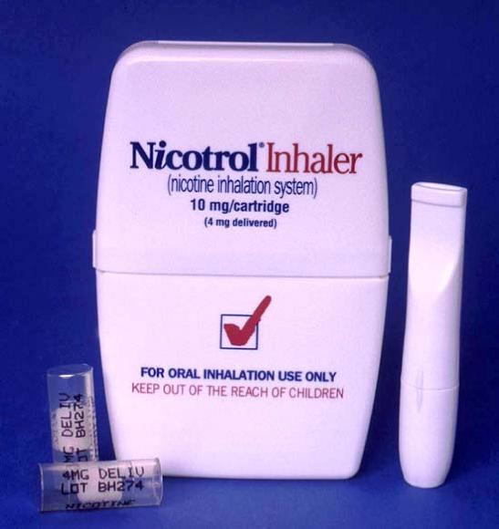

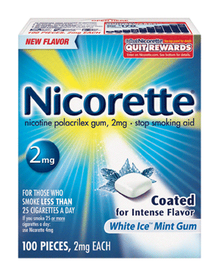

DAMIAN FAMILY CARE CENTERS, INC.
Smoking cessation counseling is conducted by our Provider staff: MDs, DOs and NPs
Smoking cessation consists of intermediate (3-10 minutes) or intensive counseling (greater than 10 minutes)
All providers have received training regarding the NYS Medicaid guidelines for reimbursement including the maximum number of counseling sessions covered in a 12 month period, (up to 6 sessions)
All providers have received education regarding NYS Medicaid approved NRTs: Nicotine gum, patches, inhalers, sprays, Zyban and Chantix

Slide 25
DAMIAN FAMILY CARE CENTERS, INC.
DFCC is proud to have instituted a “Super User” team that is primarily responsible for E.H.R. training to staff. In addition, in my role as Director of Clinical Services, I’m responsible for reviewing and implementing industry changes into our practice.
In addition, as part of our quality improvement process, the administrative team is responsible for QOC audits, conducted on a quarterly basis to ensure compliance and as a provider specific tool for evaluating performance and identifying areas of improvement.

Slide 26
DAMIAN FAMILY CARE CENTERS, INC.
Thank you!
Alison Brown, RN, MS, BSN, BA
Director of Clinical Services
Damian Family Care Centers
abrown@damianfcc.org

Slide 27
Deanna Jannat-Khah
Manhattan Tobacco Cessation Program
COMMON BILLING SCENARIOS

Slide 28

Scenario 1:
I saw a patient who smoked a pack a day and was interested in quitting. I counseled her using the 5A’s technique, documented what we discussed in her chart, and billed Medicaid for the visit using both the ICD9 code 305.1 and the procedure code 99406. A month later I found out that I was not reimbursed for this service. What happened?

Slide 29

Scenario 1: Answer
The start and stop time need to be included
The patient may have used up all their 6 face to face visits with another provider in a continuous 12 month period
Provider may not have been an eligible provider (MD, DO, NP, LM, PA)
Like many other Medicaid Managed Care reimbursements, whether or not reimbursement is distributed to the individual provider depends on whether the provider is salaried (capitated) and his/her arrangement with payers. Salaried providers will not receive the reimbursement, regardless of how payment is structured. For issues, please clarify with your plan and employer.
When in doubt call 800-343-9000 with your question or e-mail apg@health.state.ny.us

Slide 30

Scenario 2:
I saw a patient who smoked 15 cigarettes a day and was not interested in quitting. I spoke to him about the dangers of smoking towards his asthma and overall health. After ten minutes of discussion he told me that he was not interested in quitting because cigarettes were the only thing he had. Can I still bill for counseling, even though he refused treatment?

Slide 31

Scenario 2: Answer
Yes, this is still face to face smoking cessation counseling and eligible for billing. Be sure to include the ICD9 code 305.1, the procedure code 99406, as well as the start and stop time for the session and the 5 A’s.

Slide 32
Scenario 3:
I am an eligible provider who provided smoking cessation counseling using the 5 A’s to a patient who was primarily here for his diabetes care. I billed for his sole purpose of visit (diabetes) as well as smoking cessation counseling but only got reimbursed for the smoking cessation counseling by Medicaid. What happened?

Slide 33
Scenario 3: Answer
Do not use an HQ modifier; HQ modifiers are only for group sessions and are not needed for smoking cessation counseling when it is not the sole purpose of visit
Patients must be have Medicaid as their primary insurance type if they are a dual eligible (both Medicaid and Medicare)
When in doubt call 800-343-9000 with your question or e-mail apg@health.state.ny.us

Slide 34
Scenario 4:
I have a patient who is interested in quitting, however he/she does not qualify for Medicaid. Are there any other ways that this patient can get help to quit smoking?

Slide 35
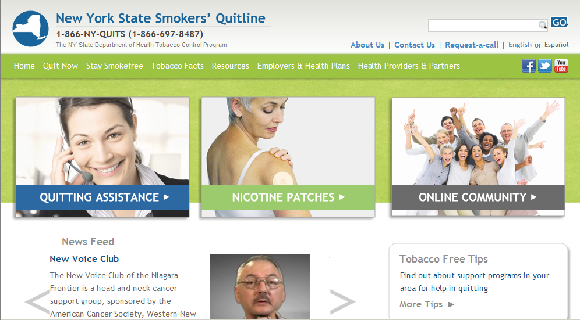
Scenario 4: Answer
For a free 2 week supply of patches and telephone coaching, NYC patients can call 311 to be referred to the NYS Smokers’Quitline, or any NYS resident can enroll online or call 1- 866-NY-Quits (1866-697-8487) directly to receive free coaching support and NRT if deemed eligible. The NYS Smokers’ Quitline is available for use to everyone living in NYS. They also have an online smoke-free community.
NYC Quits, an online resource for smokers and recent quitters, is also available to your patients by visiting nycquits.org. Your patients can register to track their progress using the Cravings Log, write about struggles and successes in a Quit Diary, see how much money they’ll save by using the Quit Calculator, read and share quit tips, test your knowledge with quizzes and much more.
Patients can get extra support from thousands of other quitters by joining our Facebook community “I Quit Because” (facebook.com/nycquits).

Slide 36


Scenario 4: Answer Continued
NYC Residents: For Medications the BigAppleRx card is a free card that provides discounts for prescription and over-the-counter (OTC) NRT, as long as a patient has a prescription. Prices and savings may fluctuate depending upon the brand; cardholders can expect an overall estimated savings up to 50% on bupropion, 17% on varenicline (Chantix®) and 27% on NRT. Patients can write the card numbers down from the card below; go to BigAppleRx.com to print the card or have the information texted to a mobile phone; or call 311 to learn more about the program and how to obtain a card. Patients should check with their plan about whether purchases using the BigAppleRx card can help meet a deductible.
NYC Residents: Quit-smoking programs across the city offer no- or low-cost medications and individual and/or group counseling. For a list of programs, please view the Guide to Smoking Cessation Programs in New York City.

Slide 37
Questions for any of the speakers?
Quick Recap of the speakers and topics:
Brief Introduction & NYS Medicaid Smoking Cessation Benefit in Practice (Sayone Thihalolipavan)
Introduction to the NYS Medicaid Smoking Cessation Benefit (Mark Tremblay)
Damian Family Care Center experience (Alison Brown)
Examples of General Billing Scenarios from the field (Deanna Jannat-Khah)

